Slide 1

FoH Presentation
To BMG team at Kofisi Square, Riverside
May 2nd, 2024

Slide 2
Who are we.......
We are non profit
We are community oriented
We strive to build healthy, literate and wealthy Garissa communities through
sustainable programmes.

Slide 3
Reason for being....
Vision
A healthy, literate and wealthy Garissa community
Mission
To improve livelihoods and well-being of vulnerable community members through strategic partnerships and implementation of sustainable programs

Slide 4
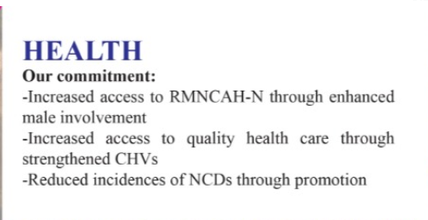
County Government and Development Partners increase funding for RMNCAH by 5% by 2024
Increase male involvement in RMNCAH-N by 35% by 2024
1400 CHVs and CBDs trained and supporting key county health committments
14,000 male and females reached with messages on NCDs

Slide 5
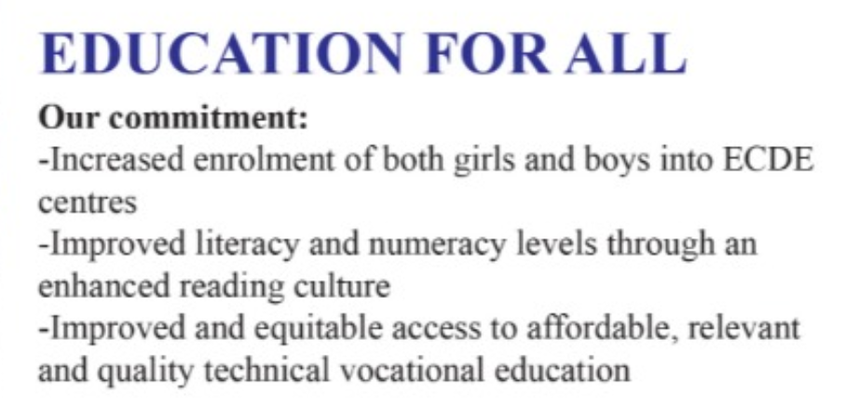
10,500 Boys and Girls enrolled and supported to complete basic education
Improved literacy and numeracy among 10,500
3500 Youth benefit from Vocational Training

Slide 6
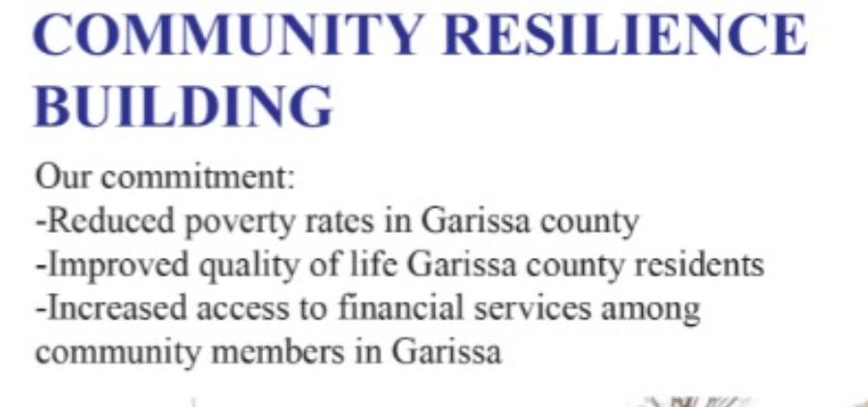
Capacity build 10,500 residents on climate change
Economically empower 10,500 refugees and host community residents through training
14,000 women and men sensitized on violent extremism and radicalization

Slide 7
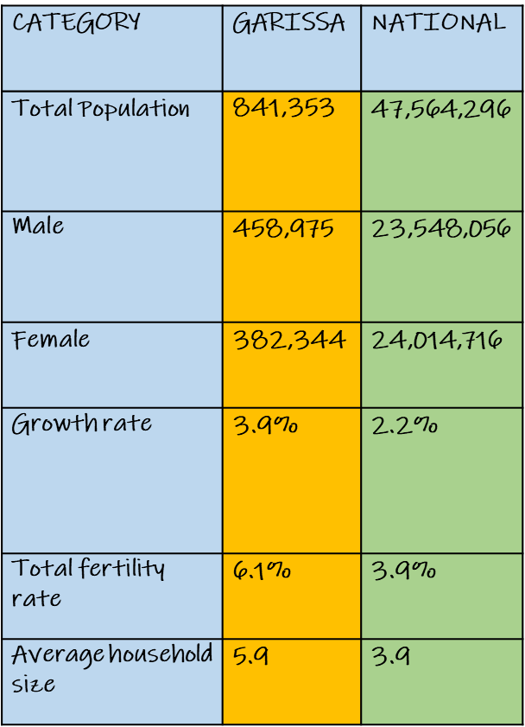
State of Population and Maternal Health in Garissa County 2018
Garissa County has;
a low population density,
high growth rate of 3.9%
high fertility rate (6.1%)
and
a high average household size (5.9)
(All compared to national statistics)

Slide 8
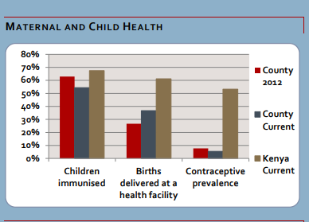
Garissa County FP Landscape
High Unmet need for modern family Planning 29.9% against 18% national rate
Lower contraceptive prevalence rate 7.1% against 58% national rate
A high maternal mortality ratio of 646 per 100,000 live births, against a national rate of 362
Garissa County is way below the National average for Child immunization, Births attended at a health facility and contraceptive prevalence

Slide 9
Advocacy for child spacing in Garissa County
Project Context:
This project sought to address missed opportunity for PPFP among post-pregnancy Muslim women with a low McPR of 5.5%, high fertility rate of 6.1% placing the county the 3rd position of contraception use in Kenya.
There were no records to indicate that women receiving ANC are counselled on PPFP
47.4% of husbands/ Partners did not know about contraception
The county is at 98% predominantly Muslim community with 94.5% not using any methods of contraception.
2019- 2020 FoH received $50,000 from FP2020
FoH implemented a 6 months RRM “Advocacy for Post Partum Family Planning Among Married Muslim Women in Garissa County”

Slide 10
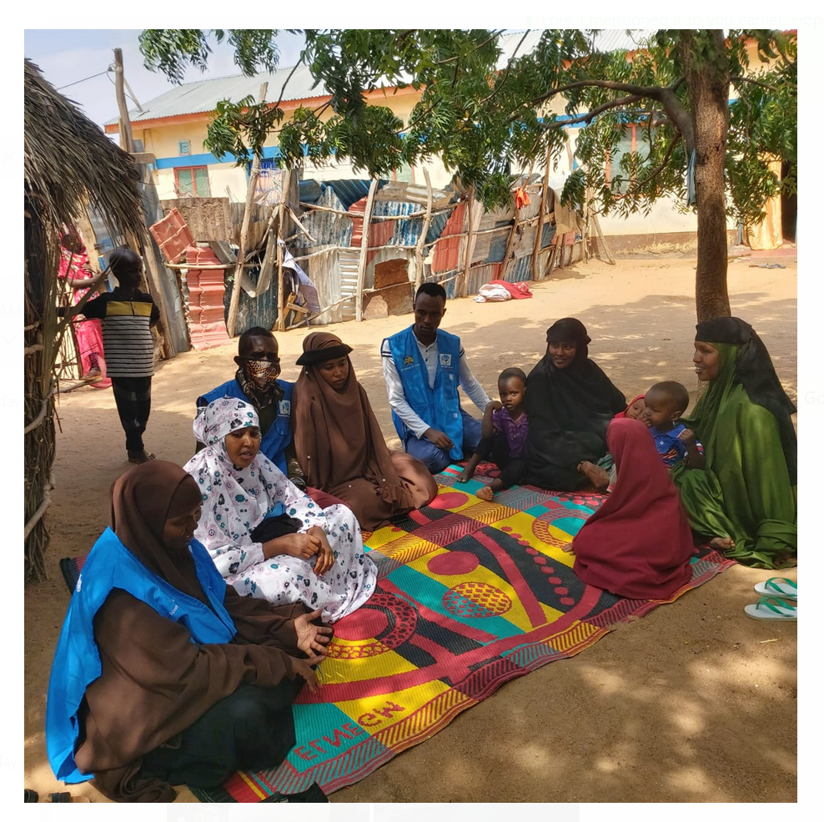
Advocacy activities,,,
Meeting with the CEC, Director- Health
Planning and landscape assessment meeting on PPFP
Advocacy Strategy Workshop
PPFP Committee Meeting
Joint Health Management Team Meeting
Meeting with CEC and County Director of Health
Meeting with Medical Superintendents and Facility In-Charges
Provider Training on FP
Meeting with male and female community opinion leaders
Meeting with male and female faith leaders
Community Dialogue Meetings

Slide 11
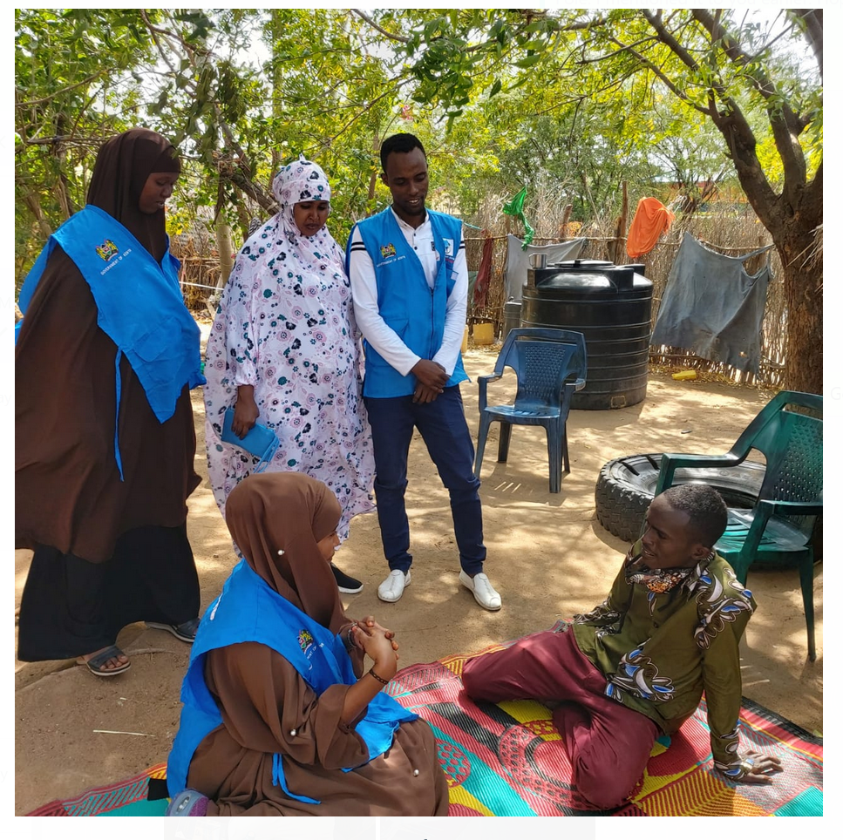
Details of Advocacy activities
1. Conducted sensitization, strategy and planning meetings for key stakeholders in Garissa County
10 (5M, 5F) – CEC health and Director –County Health Service and Chief Medical Officer
15 (8M, 7F) – Superintendents in charge of facilities
Held advocacy meeting with 40 (23M, 17F)
Deliberated on county readiness and commitment to offer FP services
Planned for roll out of the project targeting communities
Developed project sustainability strategies

Slide 12
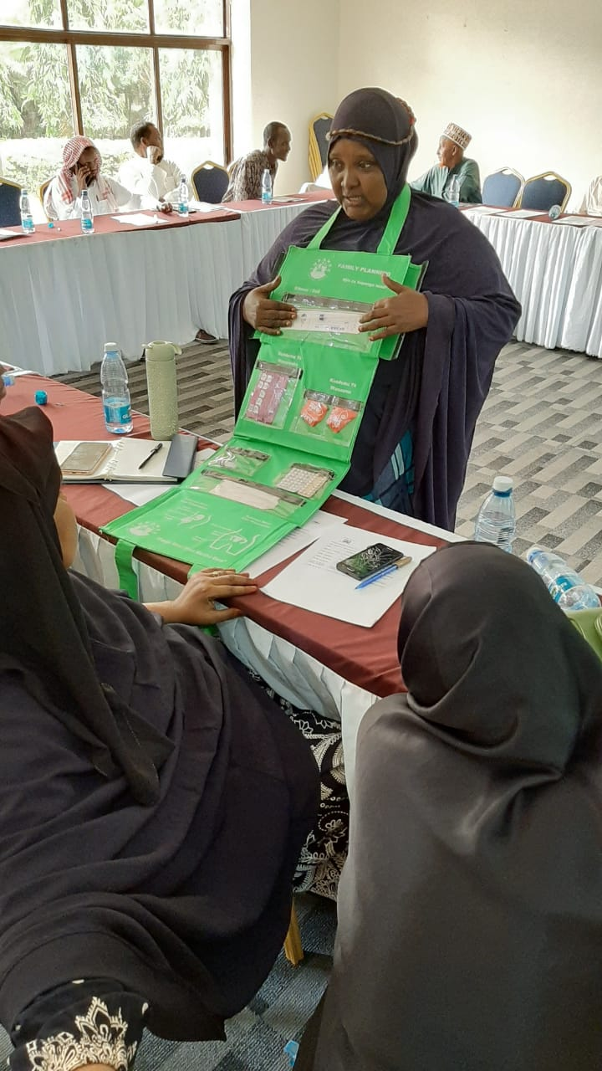
Details of Advocacy activities cont’
Provider Training on FP for 20 (7M, 13F) on;
Advanced FP Smart Approach
Kenya National FP Landscape
Comparative CPR for various counties
Culturally & Religious Sensitive FP Service provision
Increased the capacity of the service providers to use culturally and religious sensitive language during administration of FP services among Muslim women

Slide 13
Details of Advocacy activities cont’
Advocacy Meeting 1
23 Male & 17 Female Religious Leaders
Increased the perception that Islam and the Holy book of Qu’ran does not prohibit child spacing among the married women
Advocacy Meeting 2
18 Male & 23 Female Community Leaders
Increased the community support for child spacing by addressing social determinants of FP uptake among married women
Community engagements/outreach
Community Dialogue Forums with over 7000 (both direct and indirect reach)
Reduced the perception that Somali culture does not allow child spacing among married women
Held Advocacy Meetings opinion Leaders in Garissa
Increased goodwill and support for FP services in the county
Led to increased demand for FP services

Slide 14
Gender-lensed Advocacy Project
This project received a funding of USD20,000 from Jhpiego

Slide 15
Gender-lensed Advocacy in RMNCAH-N
Objective:
Increase uptake of FP as part RMNCAH-N services in Garissa Township through enhanced male participation
Activity:
Trained 17 males and 13 females as FP champions in a 2 days forum
Output:
Leaders present made a personal commitment to use their influential positions in the society to drum up support for male involvement in RMNCAH service provision and access; and address issues of SGBV, through signing a joint communique.

Slide 16
Gender-lensed Advocacy Against SGBV
Objective:
Communities in Balambala report and support legal and medical care mechanisms with care givers of SGBV involving children and young people
Activities:
i. Conducted a one day sensitization forum for 26 males and 4 females(key opinion leaders and elders) on SGBV
ii. Facilitated a community dialogue session advocating against SGBV
Output:
Establishment of a sub county SGBV Technical Working Group
Reached 130 community members at Hadley Village-Balambala subcounty

Slide 17
FP Advocacy achievements
1. Issuance of PPFP circular to all medical superintendents and MoH facility in-charges in Garissa County with the directive on immediate initiation, upscale and acceleration of PPFP in the county and record keeping for evidence based planning
Incorporation of PPFP data tools in HRMs and FP data tools is collected in sub counties and county at large.
Up-scaled PPFP services and counselling to women during antenatal visits (423 married women were reached during the 6 months of FP 2020 project implementation).

Slide 18
Achievements cont’
2. Joint Communique
Reduced perception that Somali culture and the Holy Koran does not allow child spacing among married Muslim women.
Increased good will and commitment by gatekeeper in advocacy for child spacing and SGBV
3. 25% increased male involvement in child spacing
4. KDH 2022 results that shows MCPR of 11%

Slide 19
Garissa County post partum FP data
Period | Sub Counties | Post parturm FP 4weeks to 6weeks | Post parturm FP within 48 Hours
2020 | Balambala Sub County | 10 | 11
 | Dadaab Sub County | 23 | 28
 | Fafi Sub County | 30 | 35
 | Garissa Sub County | 111 | 124
 | Hulugho Sub County | 12 | 15
 | Ijara Sub County | 22 | 29
 | Lagdera Sub County | 38 | 44
 | Garissa County | 246 | 286
2021 | Balambala Sub County | 17 | 54
 | Dadaab Sub County | 80 | 27
 | Fafi Sub County | 85 | 14
 | Garissa Sub County | 201 | 84
 | Hulugho Sub County | 11 | 13
 | Ijara Sub County | 77 | 392
 | Lagdera Sub County | 36 | 24
 | Garissa County | 496 | 595
2022 | Balambala Sub County | 8 | 17
 | Dadaab Sub County | 48 | 53
 | Fafi Sub County | 62 | 19
 | Garissa Sub County | 88 | 76
 | Hulugho Sub County | 6 | 8
 | Ijara Sub County | 61 | 250
 | Lagdera Sub County | 26 | 24
 | Garissa County | 299 | 447

Slide 20
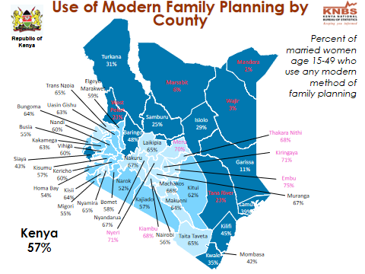
Achievements...
KDHS 2022

Slide 21
Challenges faced during FP advocacy...
Strong cultural and religious beliefs (myths and misconceptions) that are against child spacing especially for young married people
Spousal/partner opposition to use of FP methods
Early child marriage affecting girls - married off at an early age – without their consent
Poor community structures in responding to planning for a family
Erratic supply of FP commodities
Lack of and poor supply chains of FP commodities
Inadequate knowledge on FP methods

Slide 22

Challenges faced during FP advocacy......
Poor community structures in responding to SGBV.
Community members not supporting law enforcement officers in responding to SGBV
“Maslaha” is a major obstacle in seeking justice for survivors on SGBV
In 2021, 81 out of 84 SGBV cases in Balambala subcounty were resolved through Maslaha
Witnesses and law enforcement officers compromised on SGBV cases

Slide 23
Recommendations drawn from the SGBV forum...
FoH should focus on creating a linkage between the law enforcement officers and the community leadership as well as capacity strengthening for law enforcement officers
FoH to continuously advocate against SGBV and enhance response mechanisms towards support for survivors of SGBV in the county
Conduct social events between law enforcement officers and members of the community such as cultural events and football games as this will improve collaboration and coordination in advocating and responding to SGBV
Timely sharing and reporting of SGBV cases
Strengthen collaboration with male champions through coordination structures within the county

Slide 24
Recommendations drawn from the FP forum...
Sensitize communities that decision-making on contraceptive use is the shared responsibility of both men and women in Garissa County.
Develop and implement male-involvement FP initiatives that address barriers to men’s supportive participation in reproductive health, including addressing men’s negative beliefs regarding contraceptive services.
Sheikhs and Imams, opinion leaders are critical allies in the spectrum of FP advocacy and should be engaged more in design, implementation and messaging of gender-lensed advocacy in FP

Slide 25
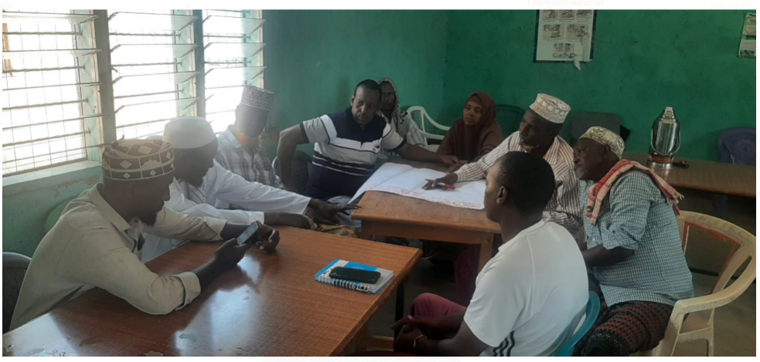
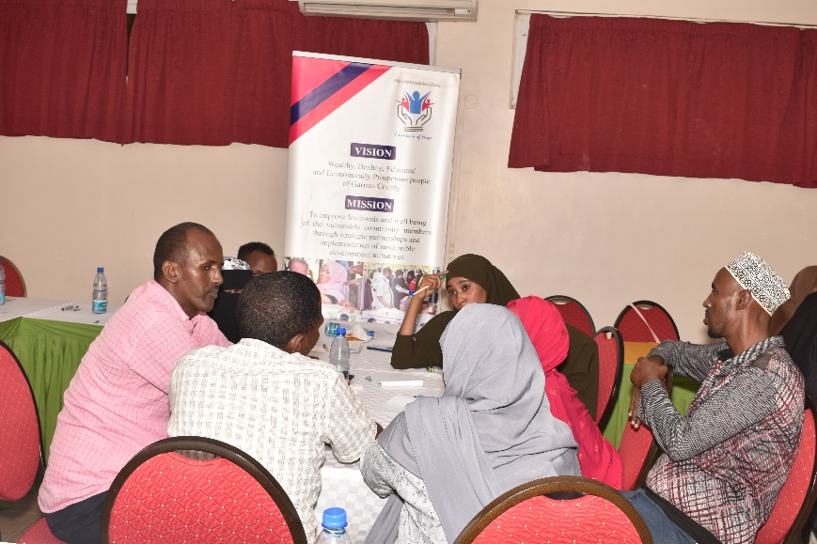
Activity photos...
Sensitization forum for key opinion leaders and elders on SGBV
2 days training of FP champions

Slide 26
Success story
https://youtu.be/f1xjqxlAAqM

Slide 27
Our ask...
More resources for further advocacy on male involvement on child spacing, SGBV and early marriage

Slide 28
Thank you

